Slide 1
Covid 19 Forecasting for Bangalore
Using Python
Nithya Sathya Kumar
Contact:endeavorels.nithyask@gmail.com

Slide 2


Why Did I Choose This Project / Dataset?
Covid-19 or SARS-CoV-2 pandemic has affected communities worldwide claiming many causalities. Governments, institute, hospitals and all related facilities have been facing challenges in being able to deal with Covid-19 patients
Managing Covid-19 affected patients has been challenging especially in India, specifically for the metropolitan city of Bangalore.
In order to achieve this objective, Covid-19 Prediction Models comes under our focus.

Slide 3
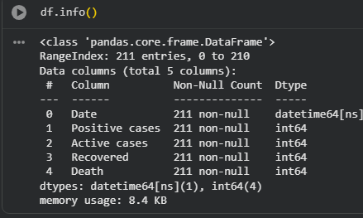
Introduction
The goal of this project is to forecast the number of Active COVID-19 cases using historical daily case data.
Accurate forecasting helps governments and hospitals prepare resources such as beds, oxygen supply, and medical staff
Focuses on the Bangalore(State in India)

Slide 4
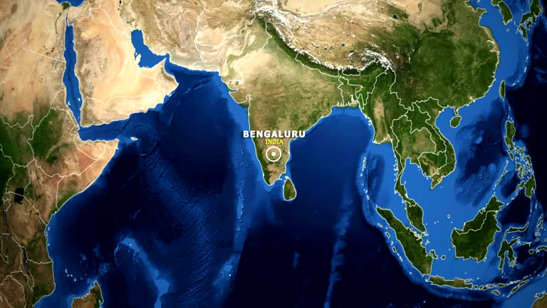
Data collection
Data Source- BBMP(Bruhat Bengaluru Mahanagara Palike) website.
Study Period - September 2020 to March 2021
Data sample – 211 entries
Type of data collected:
Positive cases
Active cases
Recovered cases
Death cases
Date
Source data(BBMP)- PDF format.
Data was imported to MS Excel.

Slide 5

Approach

Slide 6


Approach
🧹 Data Cleaning & Preprocessing
Ensured proper datetime format for consistent time series analysis.
Checked for missing values
Missing values were found in the dataset.
Average count of before and after days
Corrected the Timestamp for Date
Analysis Approach
Grouped and summed emissions by:
Grouped by Date to identify key trends in active cases
Analyzed daily and weekly trends in active cases to identify potential peaks.
Forecasted the next 7 days using ARIMA for short-term predictions.

Slide 7
Result

Slide 8
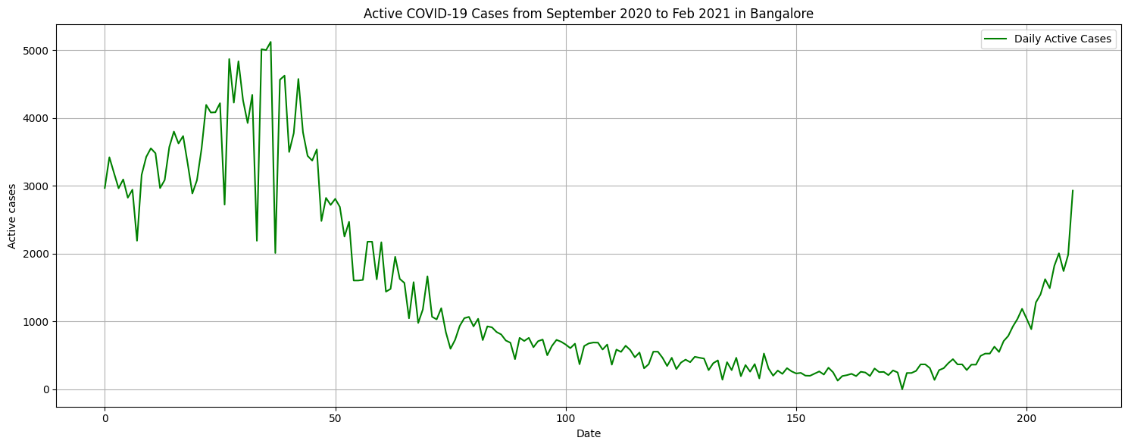
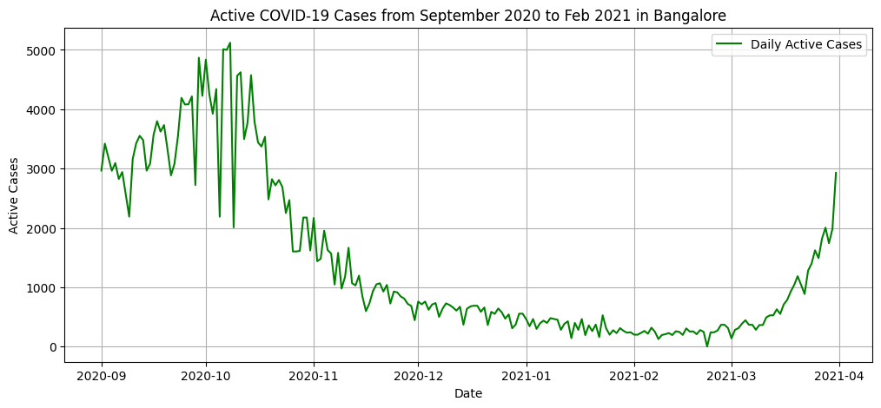
Key insights
Corrected the Timestamp for Date.
Active COVID-19 cases peaked around October 2020 (~5000 cases) before showing a steady decline
From November onwards, cases consistently dropped, remaining below 1000 active cases for several months.
Early Signs of Second Wave: From February 2021, a sharp upward trend appears, suggesting the beginning of the second wave in Bangalore
Overall Pattern: The period shows a rise → peak → gradual decline → resurgence, reflecting typical wave-like pandemic dynamics

Slide 9
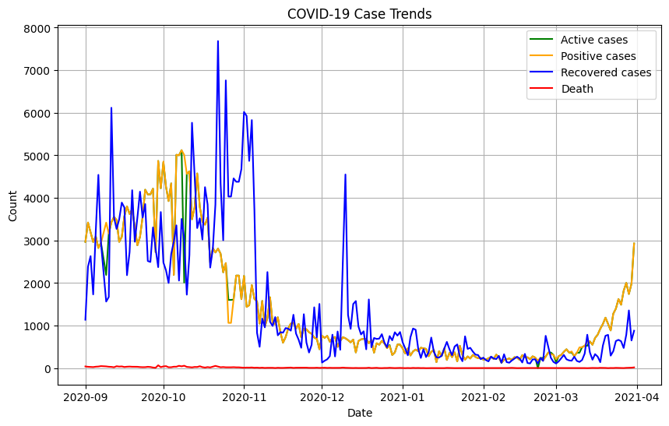
Key metrics
It visualizes four key metrics: active cases, positive cases, recovered cases, and deaths.
Positive cases (yellow line)
The line peaks around October 2020
Active cases (green line)
The highest values appear around autumn 2020
First wave: Peaks around September–November 2020
Second wave: Starts rising again around February 2021

Slide 10
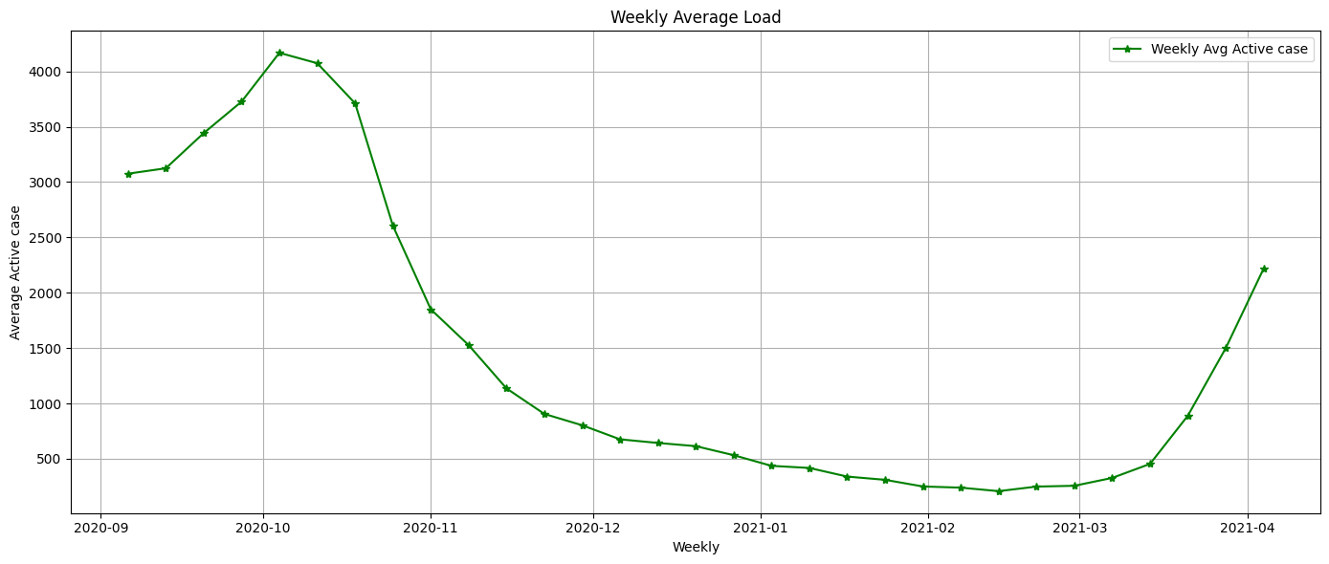
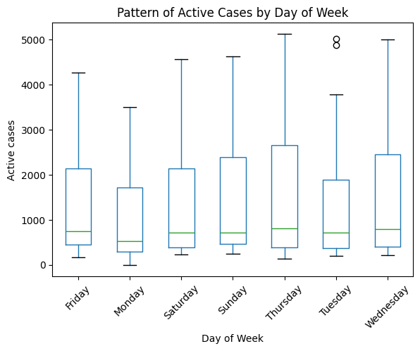
Active cases by Day of week
Weekly Average Pattern
The weekly average gradually increases towards September–October 2020, reflecting a sustained rise in cases.
After peaking, the average declines steadily through late 2020.
Day-of-Week Pattern
Lower counts on weekends
Sundays and occasionally Saturdays usually show noticeably lower reported case numbers.
Higher counts mid-week
Tuesday to Thursday frequently show the highest reported cases (as laboratories and health departments clear accumulated tests from the weekend)

Slide 11
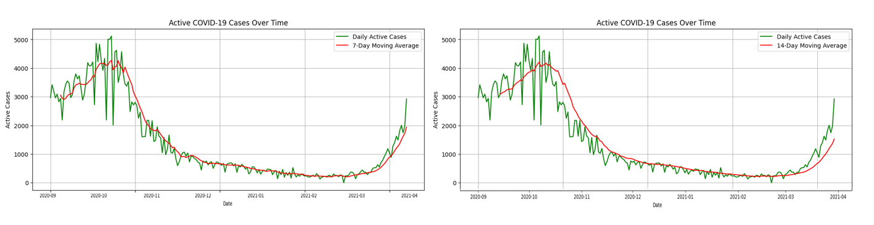
Moving Average Trend
The moving average smooths out daily fluctuations and highlights the true underlying direction of COVID-19 cases.
Clean, reliable depiction of COVID-19 case trends across the entire period.
Rise → Peak → Sustained Decline → Renewed Rise,

Slide 12
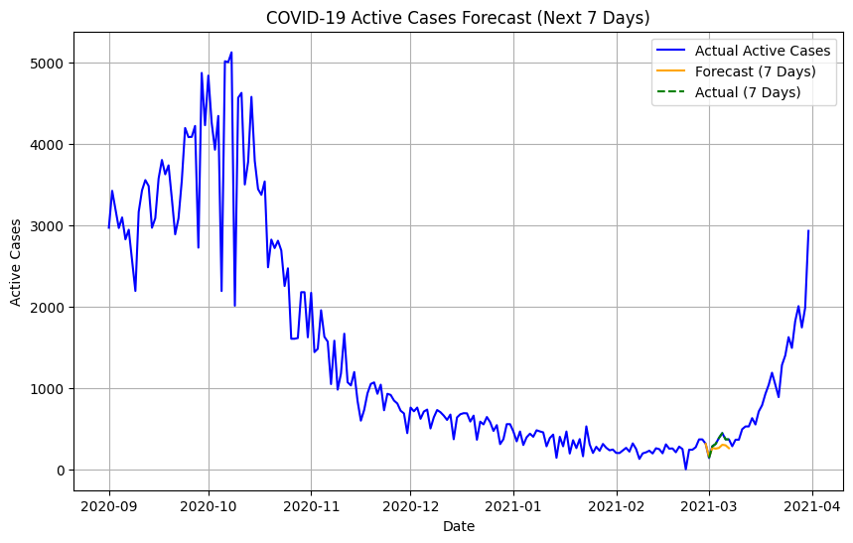
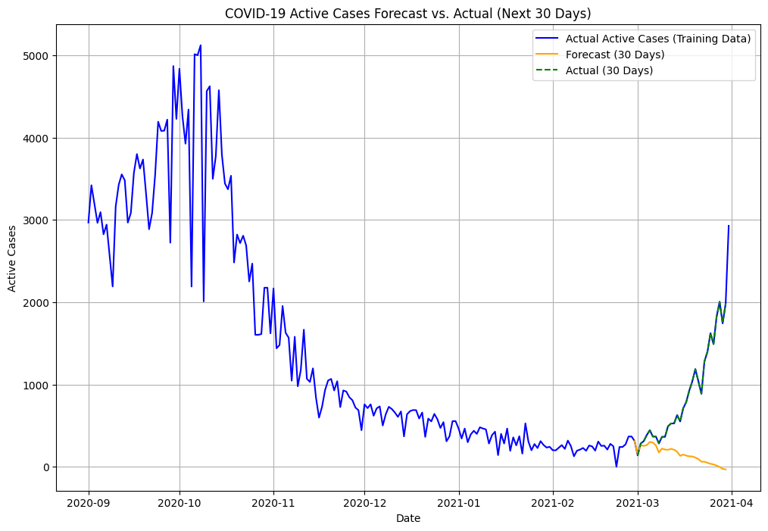
Forecasting for March 2021
Forecasting using next 7 days and 30 days
Short-Term Projection
In the short-term (7 days), forecasts tend to be highly reliable
daily fluctuations are minor and mostly predictable
Actual values are usually within 5–10% of the forecast
Long-Term Projection (1 Month)
Over 30 days, forecasts become less precise
transmission conditions can change quickly
Actual values may differ by 20–40% from forecast levels after one month
https://github.com/Nithyask-source/ReDI_COVID19_Forecast_Project

Slide 13
Challenges and How I Overcame Them
Challenges
KeyError issues caused by case sensitivity and slight differences in naming
The dataset required manual transcription from PDF to Excel, which was time-consuming
The forecast models could be improved with more extensive or higher-resolution data
The dataset had fewer columns
AI Tools
I took help of ChatGPT to help me learn few concept, debugging code ;)

Slide 14
Future improvements
Use advanced forecasting models (e.g., Facebook Prophet, LSTM deep learning networks).
Extend the forecasting for other columns Build an interactive dashboard.
Build an interactive dashboard

Slide 15
Any Questions

Slide 16
Thanks a lot!

